Slide 1

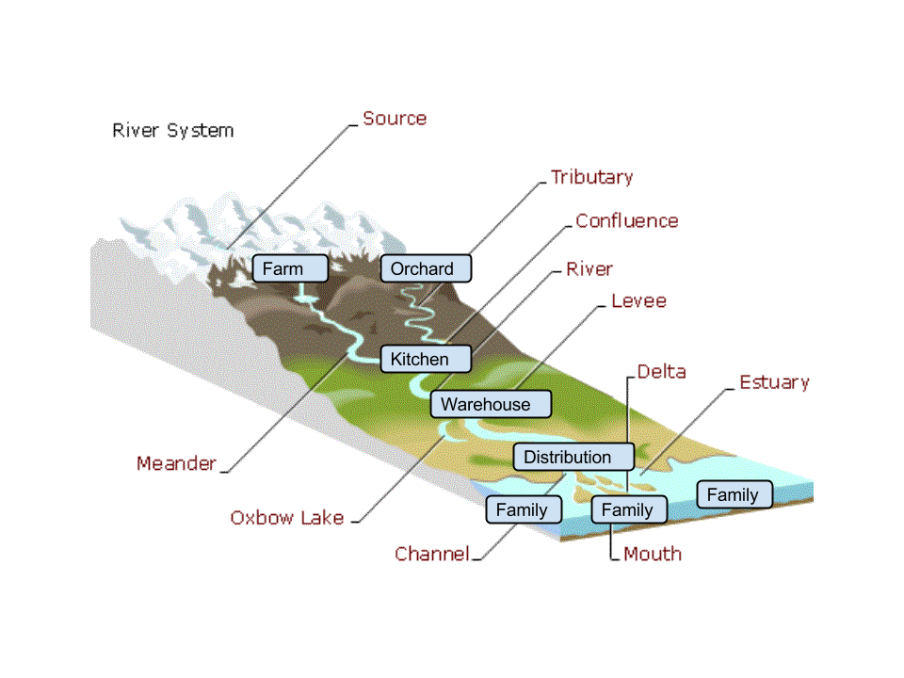

Slide 2
Value Flows….
Resource
Input
Event
Process
Output
Event
Resource
Input
Event
Resource
Input
Event
Process
Output
Event
Resource
Process
Output
Event
Resource
Input
Event
Resource
Input
Event
Product/service
Collaboration
Reputation
Reward

Slide 3
Accounting as in Accountability...
from peers to each other
from members to the network
from the network to the members
from one network to another
from the network to the community
from the network to the ecosystem
Since all the data is recorded as the economic activity happens and stored in its most basic form, you can get separate accounting views for: a network, each organization in the network, each project, each individual.

Slide 4
input
output
resource
process
resource
Value Network
network of networks
Community
Multi-stakeholder
Co-op
Regional Economic
Ecosystem

Slide 5
Classification
Recipe Input
Process Classification
Recipe Output
Recipe Input
Process Classification
Resource Classification
Resource Classification
Plan
Input Intent/
Commitment
Output Intent/
Commitment
Input Intent/
Commitment
Process
Process
Observation
Economic Resource
Input
Economic Event
Output Economic
Event
Economic Resource
Input Economic
Event

Slide 6
Salsa Recipe
for 1 lb of Salsa
(fills 2 jars)
1 lb Diced Tomato
Cook Salsa
1 lb Salsa - Bulk
1 lb Salsa - Bulk
Package Salsa
Diced Tomato
Salsa - Bulk
Plan:
Order for 12
jars of Salsa
6 lb Diced Tomato Today
6 lb Salsa - Bulk Today
6 lb Salsa - Bulk Today
Cook Salsa Today
Package Salsa Today
Observation:
Salsa
Events
Diced Tomato Lot 234
Consumed 6 lb Diced Tomato Lot 234
Produced 6 lb Salsa - Bulk Lot 456
Salsa - Bulk Lot 456
Consumed 6 lb Salsa -Bulk Lot 456

Slide 7
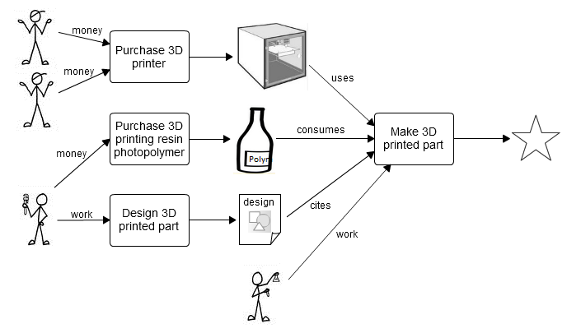

Slide 8
